Slide 1
Information Design
Scott Klemmer tas: Marcello Bastea-Forte, Joel Brandt, Neil Patel, Leslie Wu, Mike Cammarano
25 September 2007

Slide 2
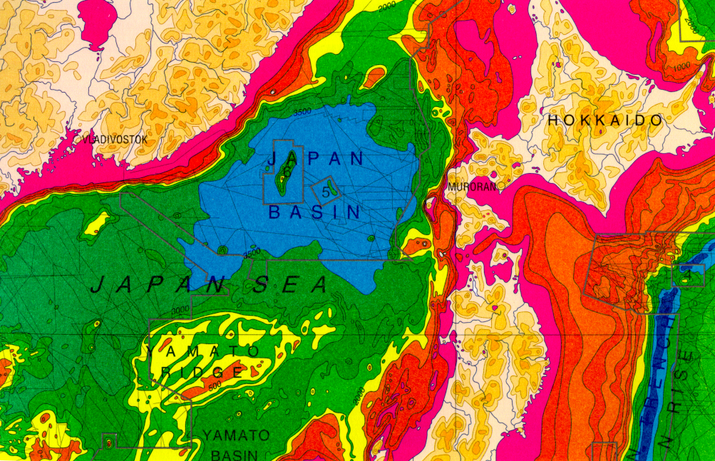
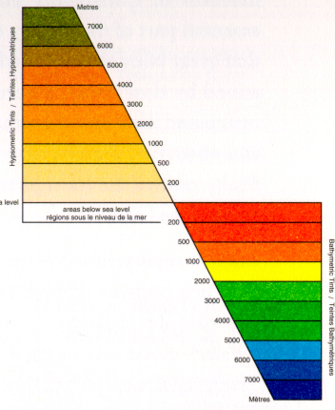
Cartography - Color: Edward Tufte
IMAGE REMOVED
Notes:
While it is certainly true that hues have a physical order via their wavelength, and that every kindergardner knows the rainbow ordering, our visual system has a very difficult time treating hue in an ordered way. As we see in this image, it is clear that each area is *different*, but none of the areas have an intuitive relationship between each other. Where is above ground? Where is below? What’s the highest point? These questions are hard to answer. (Saturation as a cue is nearly impossible to handle.)
This is how most computer scientist would design a map.
This is supposed to convey height above sea level.

Slide 3
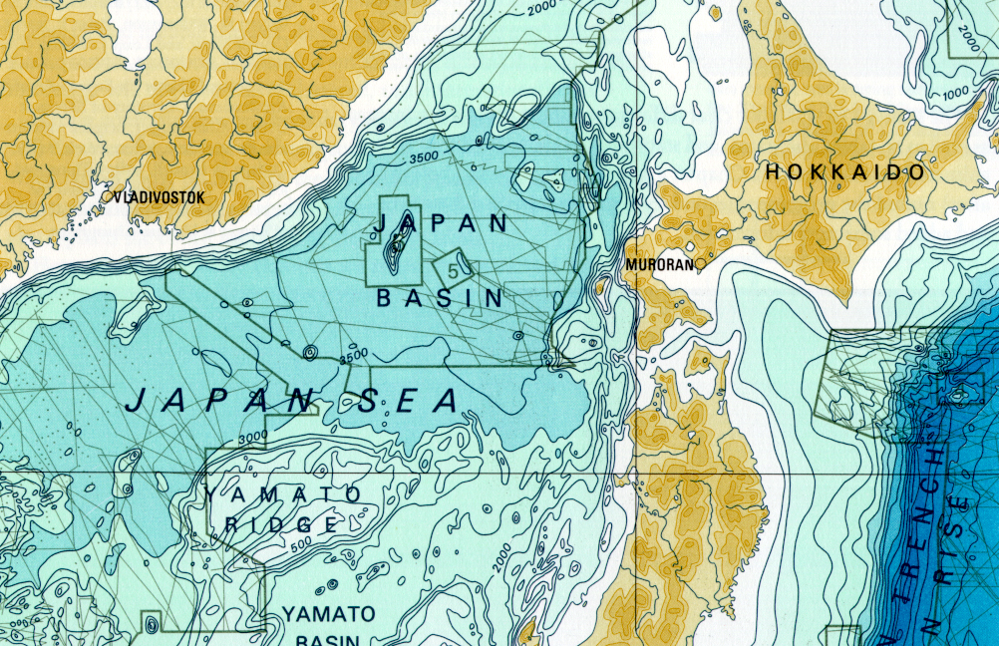
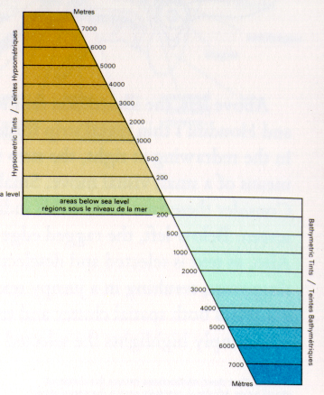
Color: Edward Tufte
IMAGE REMOVED
Notes:
Color sets that vary primarily by luminance are much easier for us to order. This image uses two color sets: browns for above ground, blues for below. The questions I mentioned before are now much easier to answer. The much more muted colors also much easier to read the information.
Cartographers have been doing this for 2000 years.
The key is to know: under water or not under water? Then, how far for each case? I perception system can’t use hue for how much! But, we can use intensity. As I go deeper, the color gets darker. Intensity is a great axis for presenting quantitative information.

Slide 4
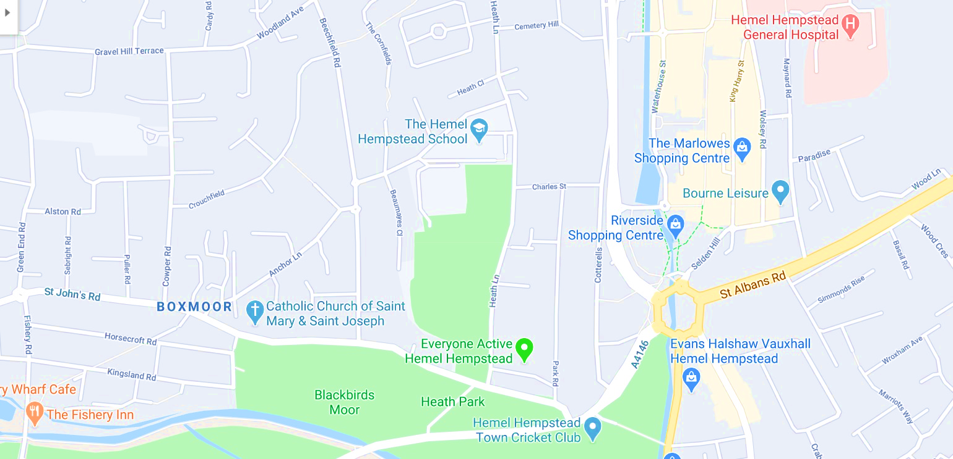
Color: Google Map

Slide 5
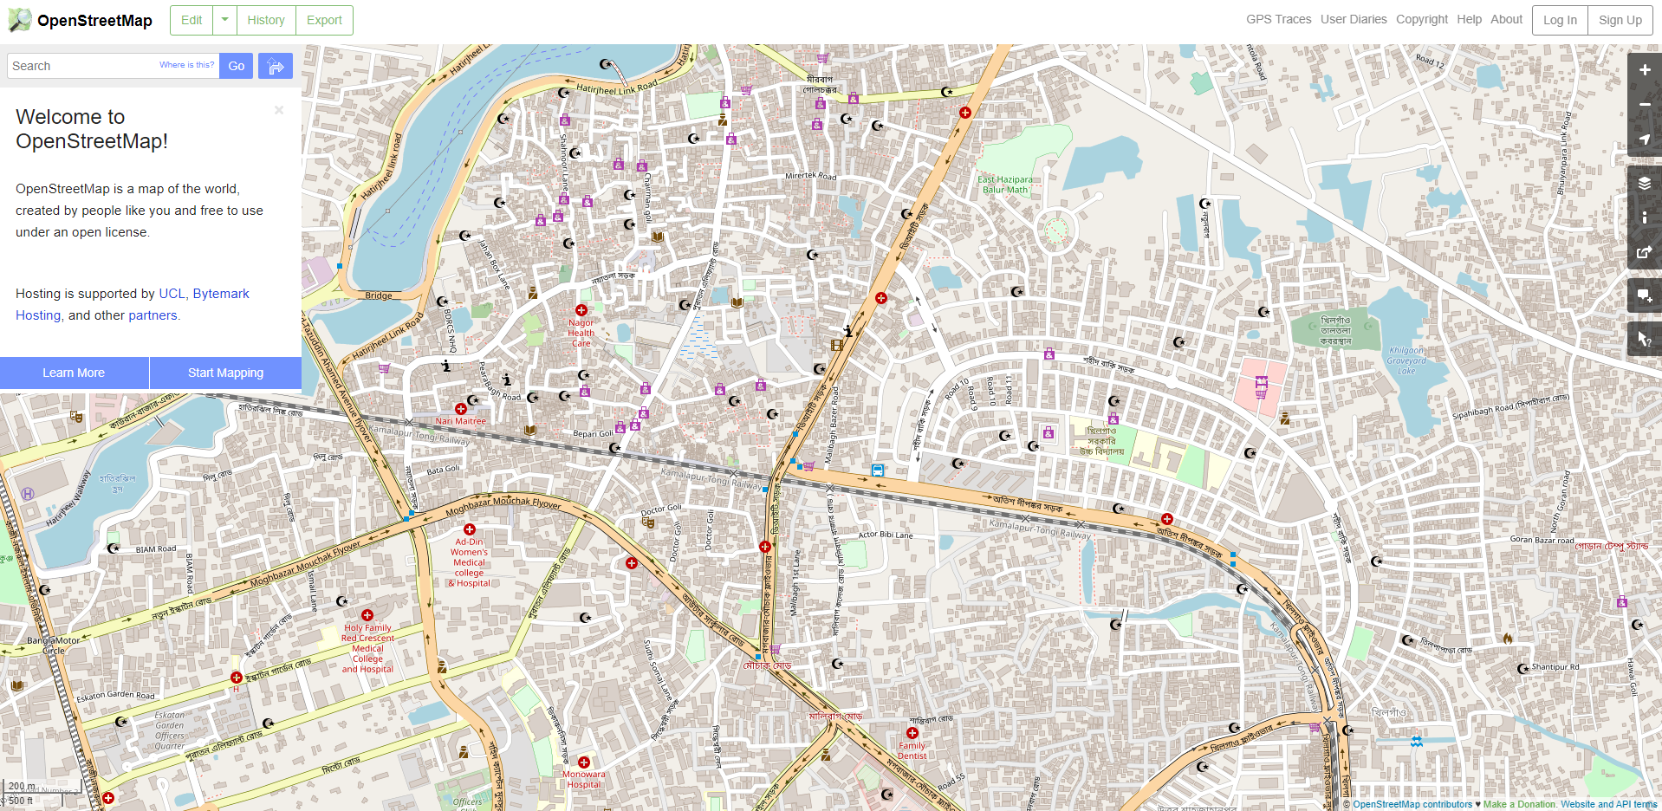
OSM: Open Street Map
https://www.geonames.org/

Slide 6
Perception of color
RED
BLUE
GREEN
CYAN
MAGENTA
YELLOW
RED
BLUE
GREEN
CYAN
MAGENTA
YELLOW
RED
BLUE
GREEN
CYAN
MAGENTA
YELLOW

Slide 7
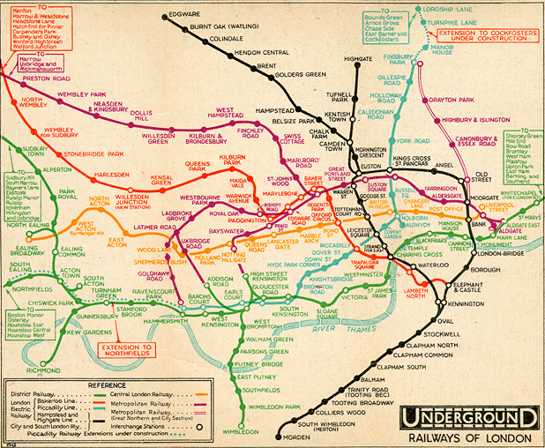
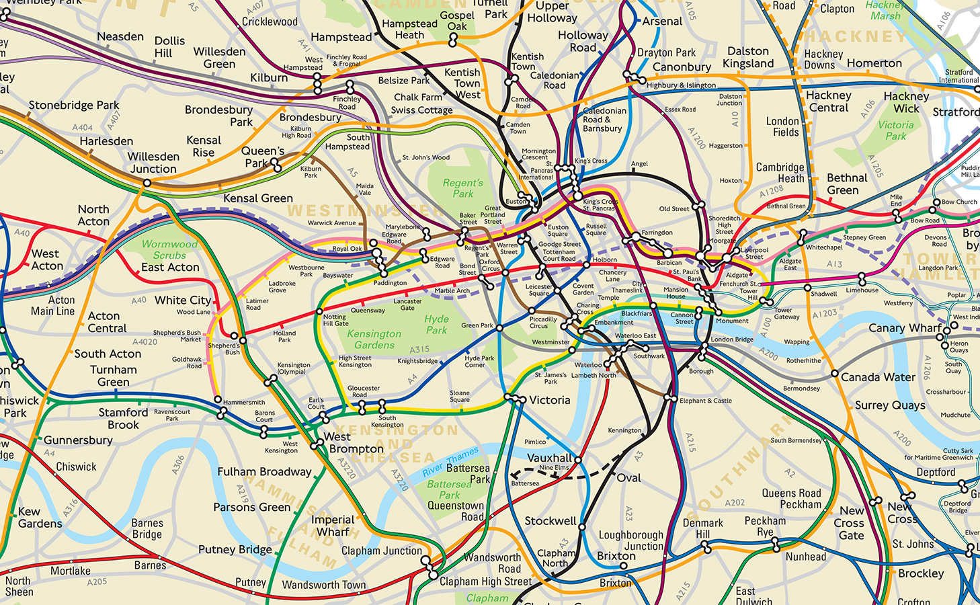
London Underground
Find cognitive and perceptual principles
Optimize the visualization according to these principles

Slide 8
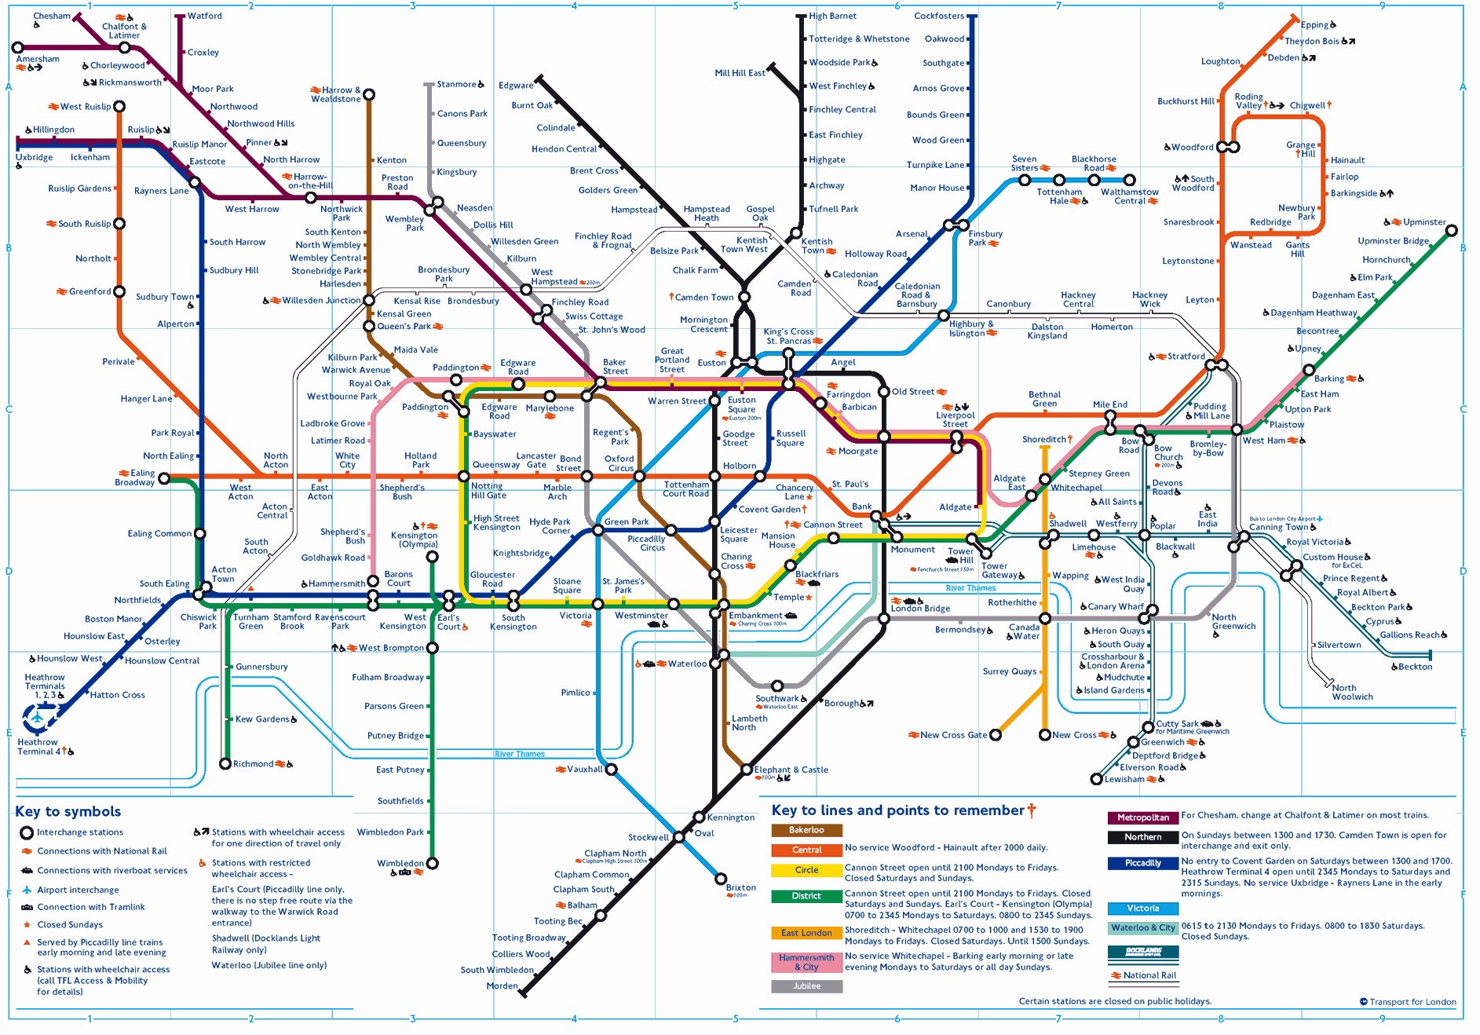
London Underground (Harry Beck)
Notes:
Abstraction is key to design. This is one of the best examples. First subway map to notice that public transit map doesn’t need to exactly follow the path that the trains/buses follow. What is important is the general direction & what are the stops. This makes is MUCH easier to read (you don’t need to know all the little wiggles).

Slide 9
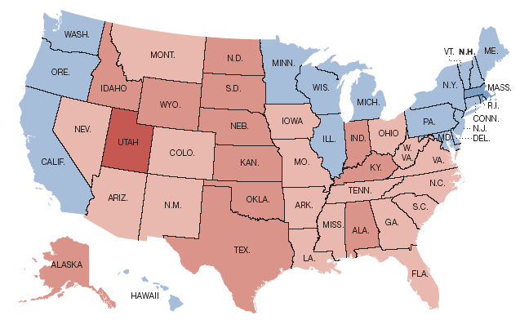
2004 presidential election
Matthew Ericson, NY Times

Slide 10
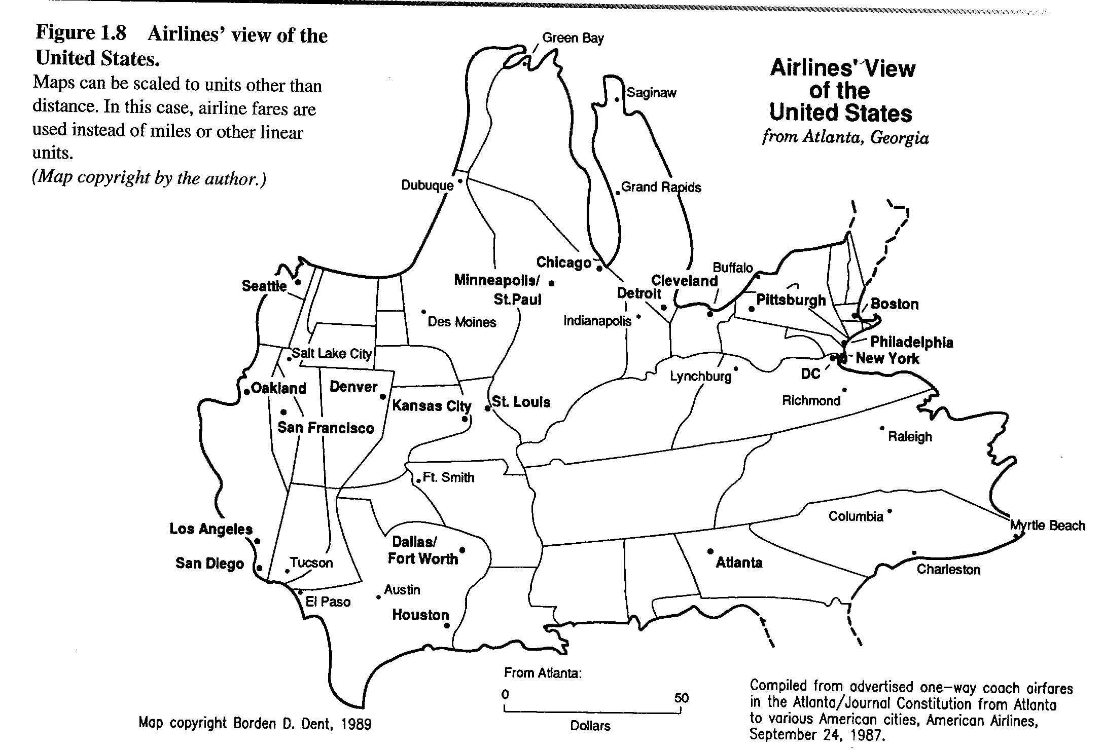
From Cartography, Dent
Notes:
Map scaled to airline fares

Slide 11

Minard (1861)
Notes:
Describes Napoleon’s March to Moscow in “The War of 1812”
Drawn in 1861 by Charles Joseph Minard.
Combination of a map and a time series. Five variables are plotted: location, time, size
and temperature (Tufte includes direction).
Beginning at the left of the map is Polish-Russian border near the Neiman River. The
Thick band shows the number of soldiers in the army.
Napolean started with 422,000 men in June of 1812;
100,000 reached Moscow in September 1812;
Temperature vs. time is shown in the graph on the bottom. The highest temperature is
0 and it goes to -30. The time runs from October on the right to December on the left.
The crossing of the Berezina River was a particular disaster.
Image from http://www.edwardtufte.com/tufte/minard
Text paraphrased from Tufte, VDQI, p 40.

Slide 12

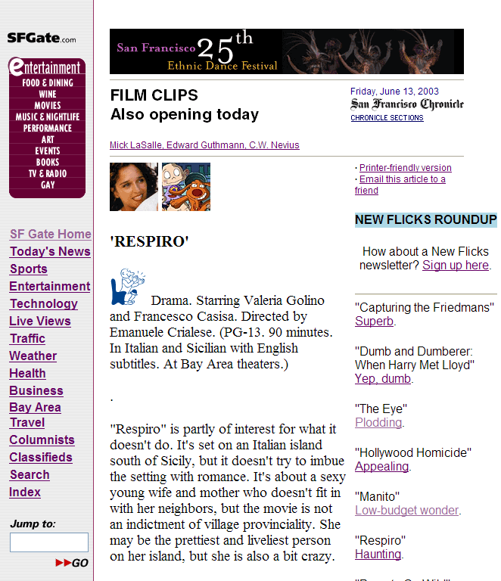




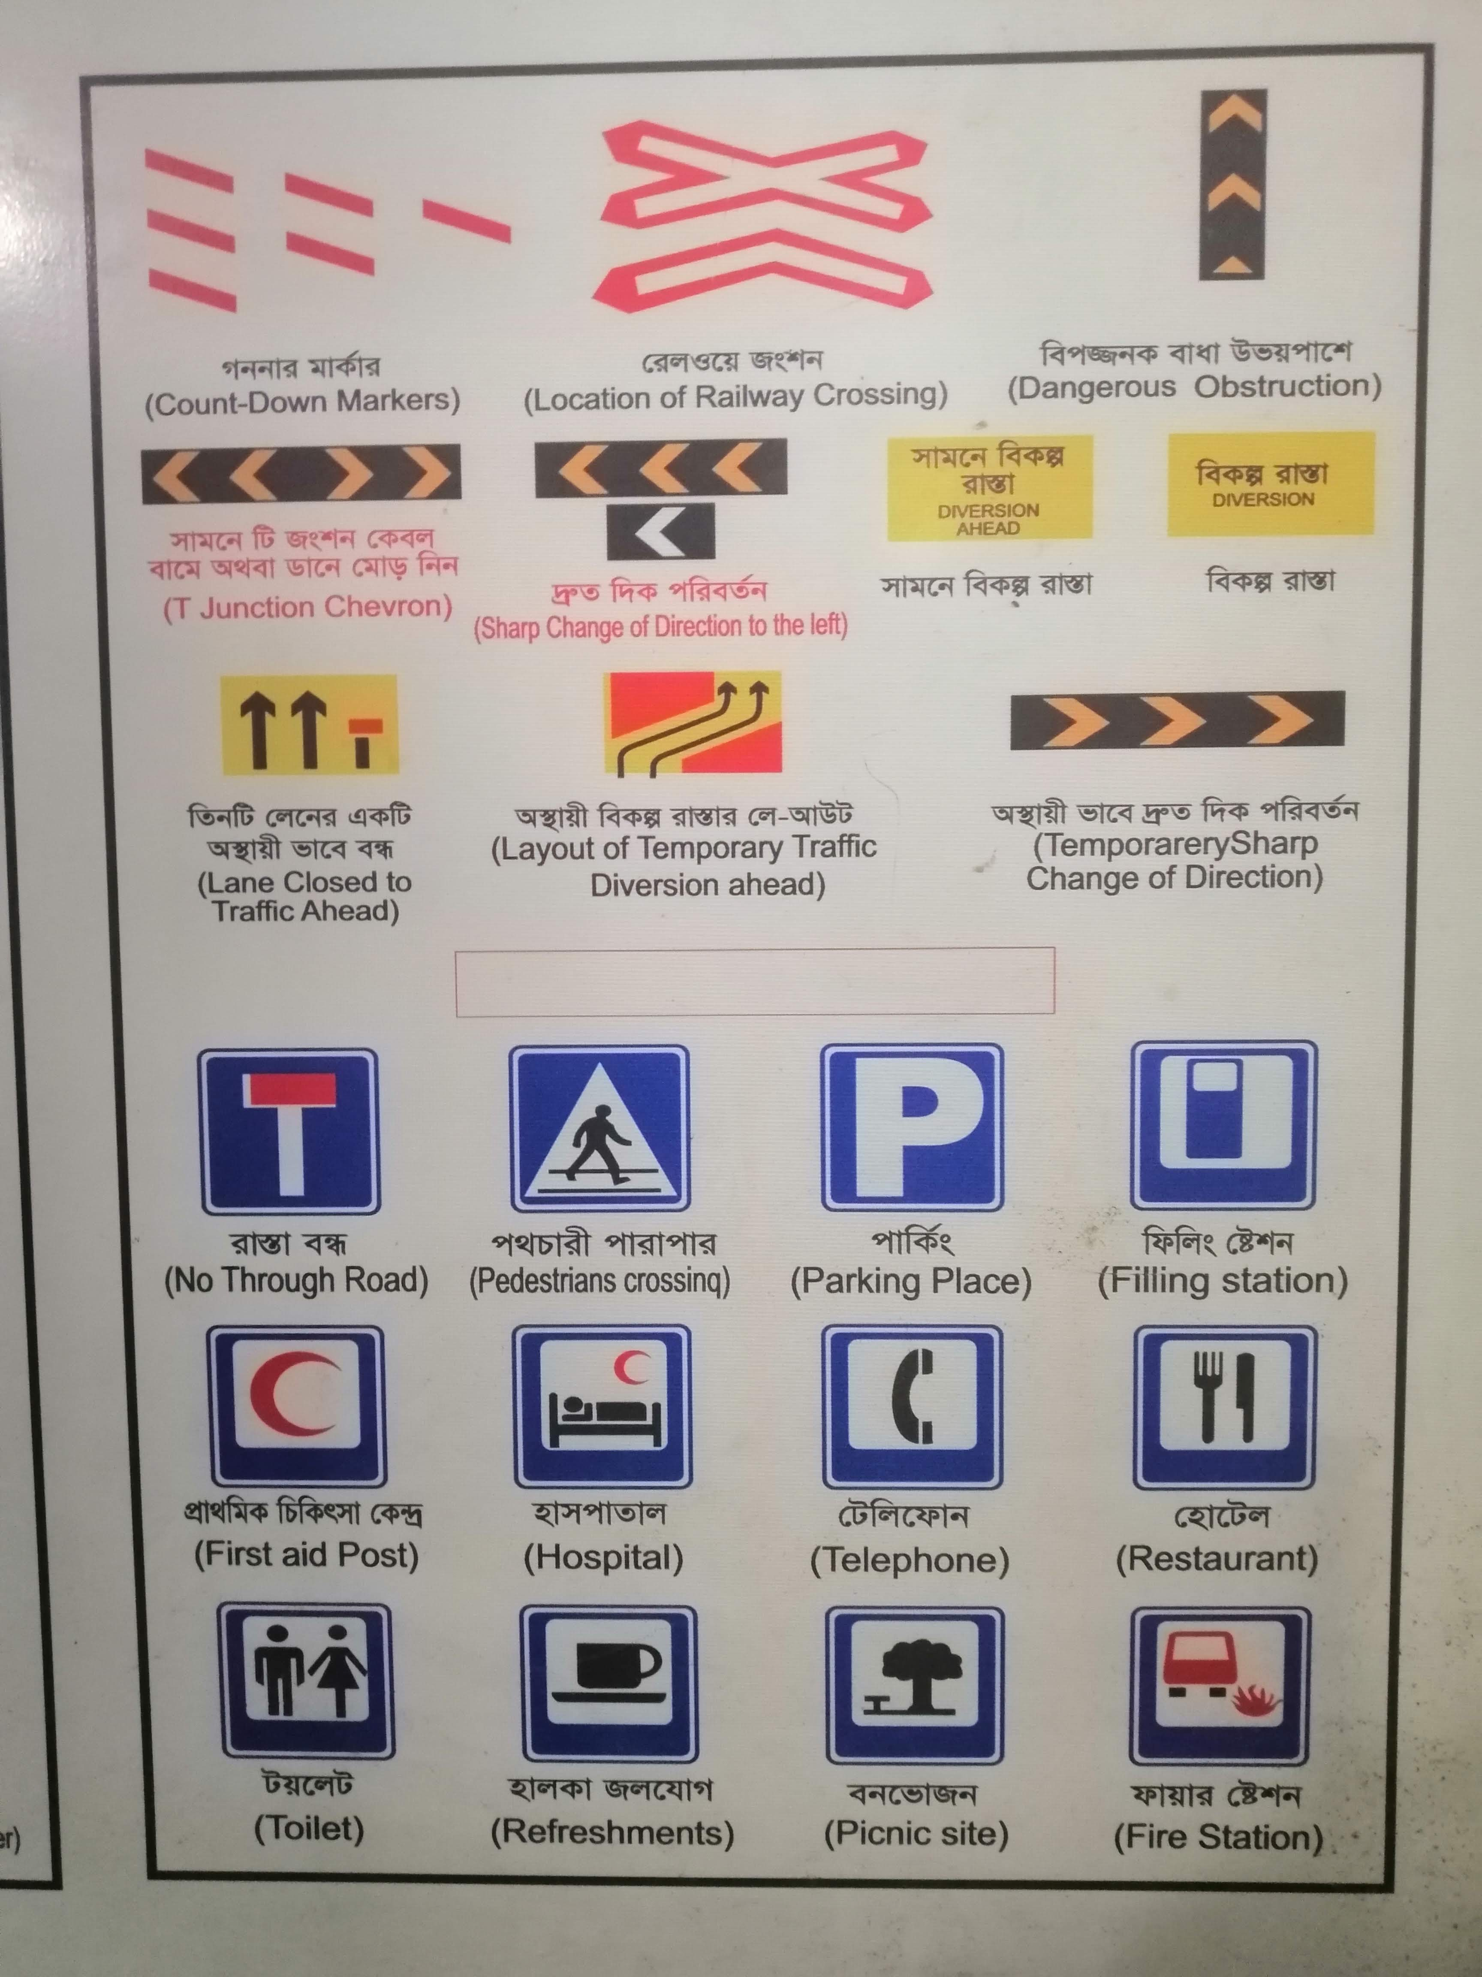
Semiotics
Notes:
Set of Axis.
Chronicle film schema is cute, but can never remember how good this is. If you have the entire scale and they are ordered it makes sense.
E-bay’s is even worse. Depending on how many items you have sold you get a different star. Can anybody tell me why the ordering? Totally random.
A more effective way is to have the entire scale with it partly filled in (3 stars filled in, 2 stars emptied). Stars superior to numbers since I can see this pre-attentively very quickly without having to read & think. If you gave me 1000 movie backgrounds, you could quickly see which ones were good.

Slide 13
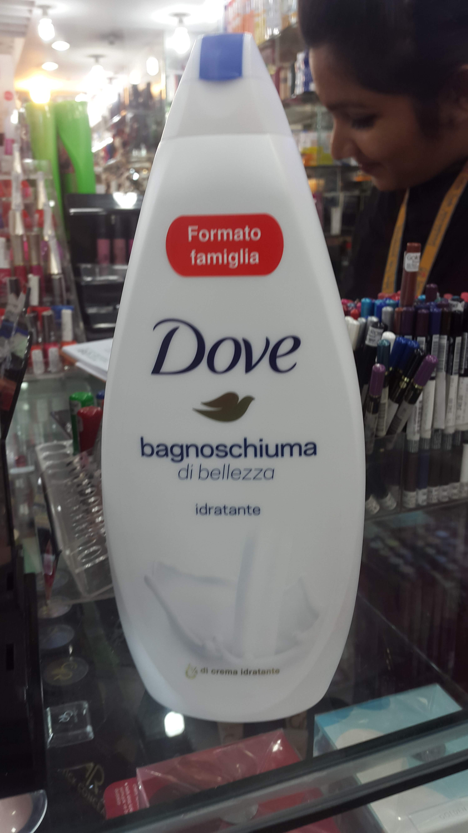

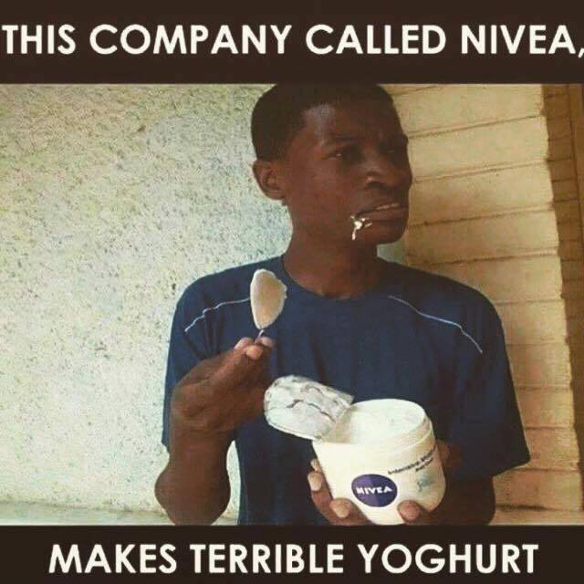
This made no sense
Shower gel
of Beauty
Moisturizing

Slide 14
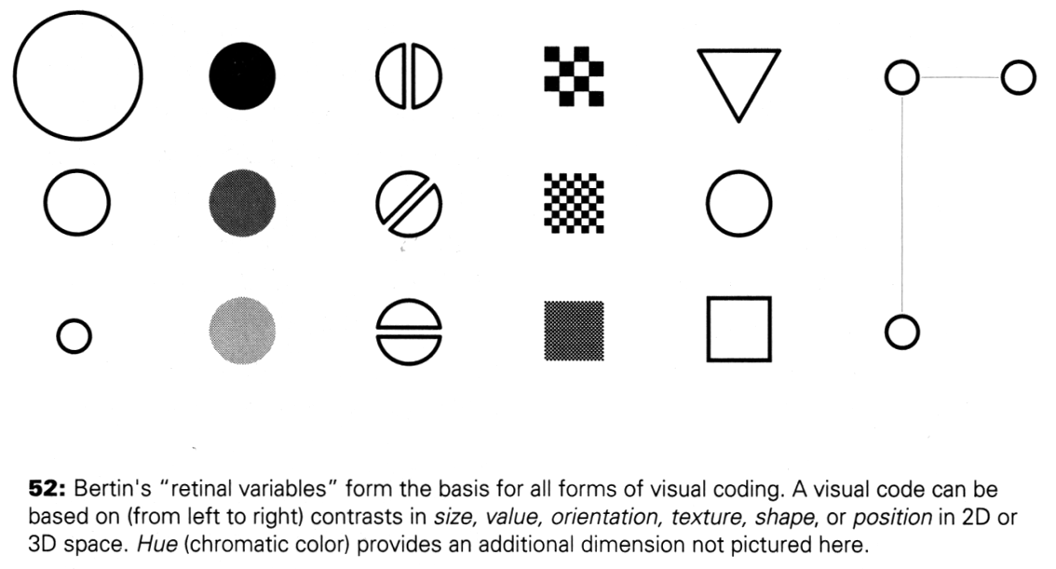
Proportion and Scale
Kevin Mullet and Darrell Sano, Designing Visual Interfaces
Notes:
Note that while size and other cues provide for quantitative comparison, color (even luminance) only provides for ordering.
If the goal is contrast along any of these axes, make it distinct!
Forms of visual coding. What can we notice very quickly:
size, intensity, orientation, texture, shape, position in space.
Take advantage of these variables to present information.

Slide 15
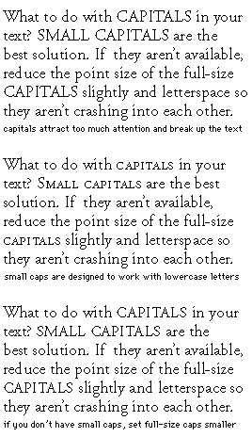
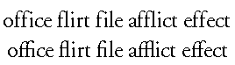
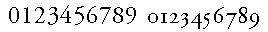
Marks of Typographic Style
Ligatures
Upper and lower case numbers
http://www.adobe.com/type/topics/info5.html
Notes:
Tips & tricks to make type look good:
Capitals only appropriate for the beginning of sentences. Use “small capitals” if you want it to read smoothly. Can still read it and see there is something different. (HTML “small” tag lets you do this)
see f’s crashing into each other. Good type faces (in print & books) have letters properly designed to go together (fi, fl, ff)
numbers come in upper & lower case. Upper cases numbers are like all CAPS. Hard to read. More variation in lower case (some acenders & decenders). Lower case numbers also called “old style”

Slide 16
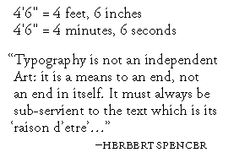
Proper Quotes
Distinguishing open from close makes reading easier
Tags in HTML have open and close, e.g., <html> as opposed to |html|
Spanish has open and close exclamation, question mark, e.g., ¡hay caramba!, ¿que pasa?
Quotes “ ” have open and close too
Quotes in HTML
&#8220; “ Left Double Quotation &#8221; ” Right Double Quotation &#8216; ‘ Left Single Quotation &#8217; ’ Right Single Quotation
Notes:
Two vertical bars are NOT quotes. They are inch marks!
Key is that quotes have open & close. You get the hint it is the beginning or end.

Slide 17
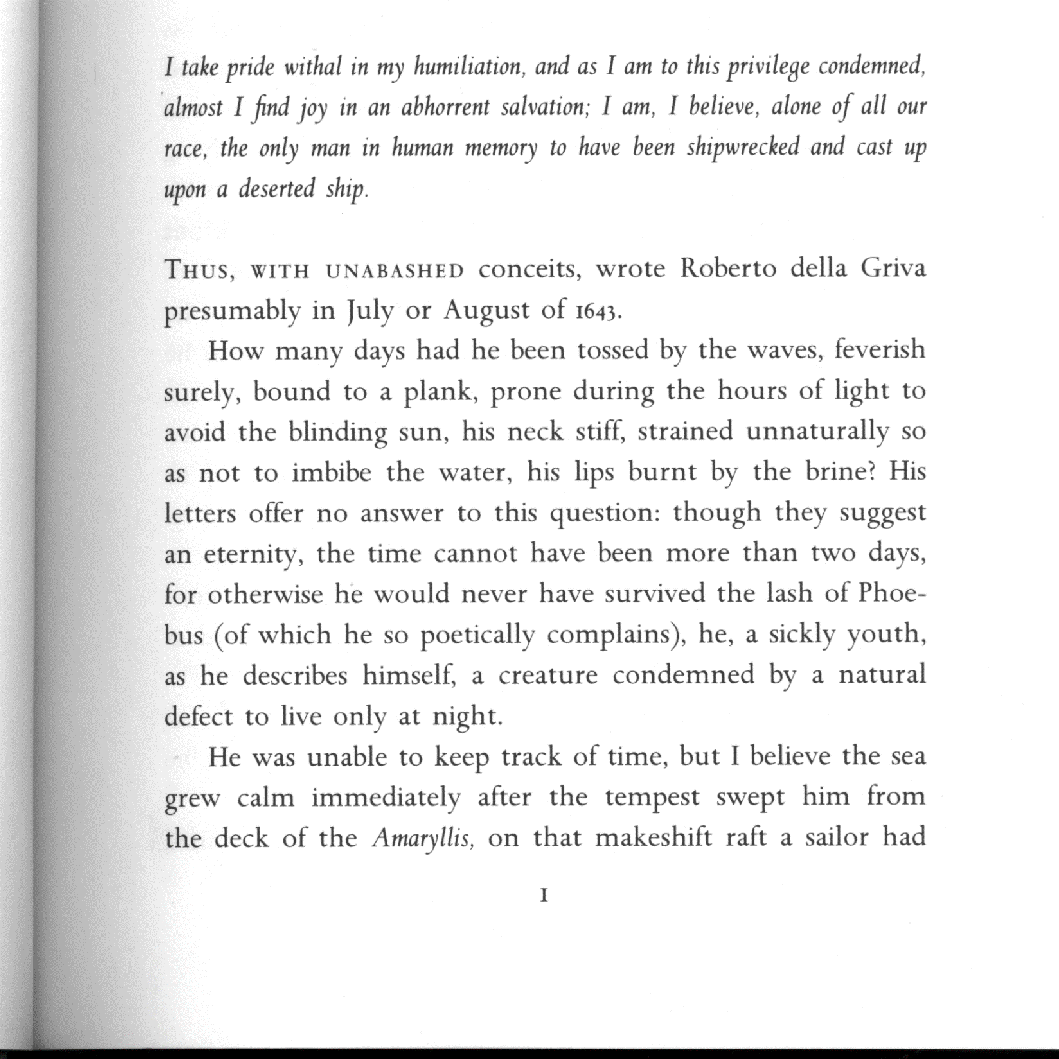
Notes:
Scan of a well typeset book. Umberto Eco’s “ ? “
Plenty of line space, but not double space.
Good use of roman and italic version of the face. Character talking to himself is in italics.
Beginning of chapter has the first few words in small caps. Common in good typeset magazines & books.
Lower case numbers.
Lots of white space around the edge. Easier to read (less distracted by what is behind the book). Also don’t curve things near the spine.
Tend to be 75-80 characters a line in well typeset books (printing in IE might give you 150 characters / line – you have to move your head to read it).

Slide 18
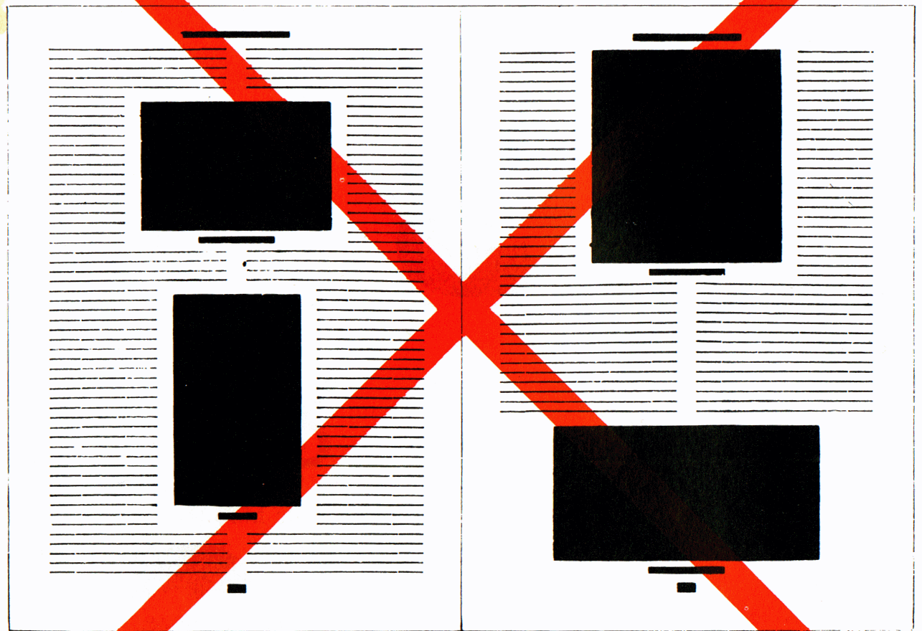
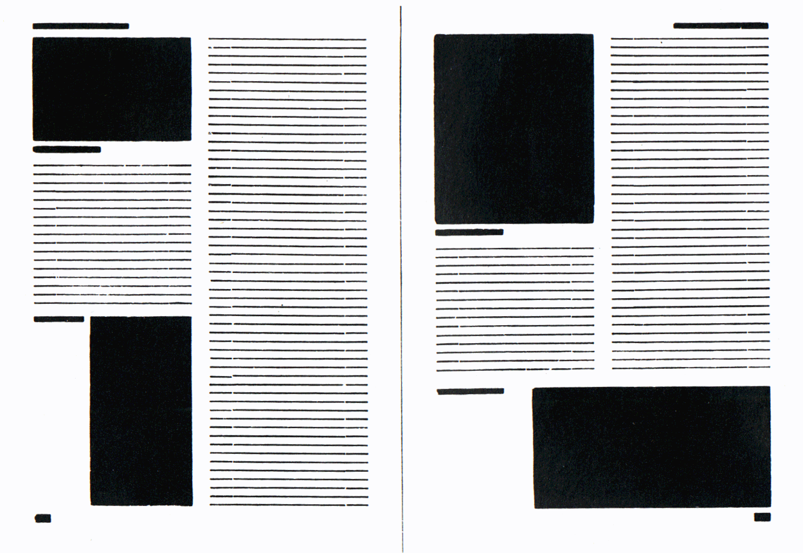
Asymmetric Typography
J A N T S C H I C H O L D
How blocks used to be arranged in magazines. Schematic, thoughtless centering of blocks (= ugly).
The same blocks, correctly arranged in the same type-area. Constructive, meaningful, and economical (= beautiful).
Notes:
Main tenant of modernist design
In books before the Bauhaus, everything was centered.
Harder to read.
Asymmetric: 1) feels more dynamic (energy to the type), 2) don’t have difficult to read narrow columns around the figures.

Slide 19
Some Starting Points
Gather materials you find successful
Could be from a very different domain
“Good artists borrow, great artists steal” - Picasso
Include visual design professionals in the iterative design cycle
Notes:
Much of picasso’s paintings came from stealing the design of African masks.

Slide 20
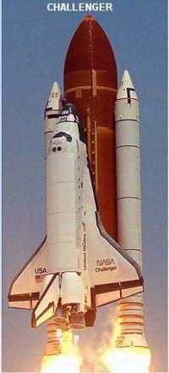

Slide 21
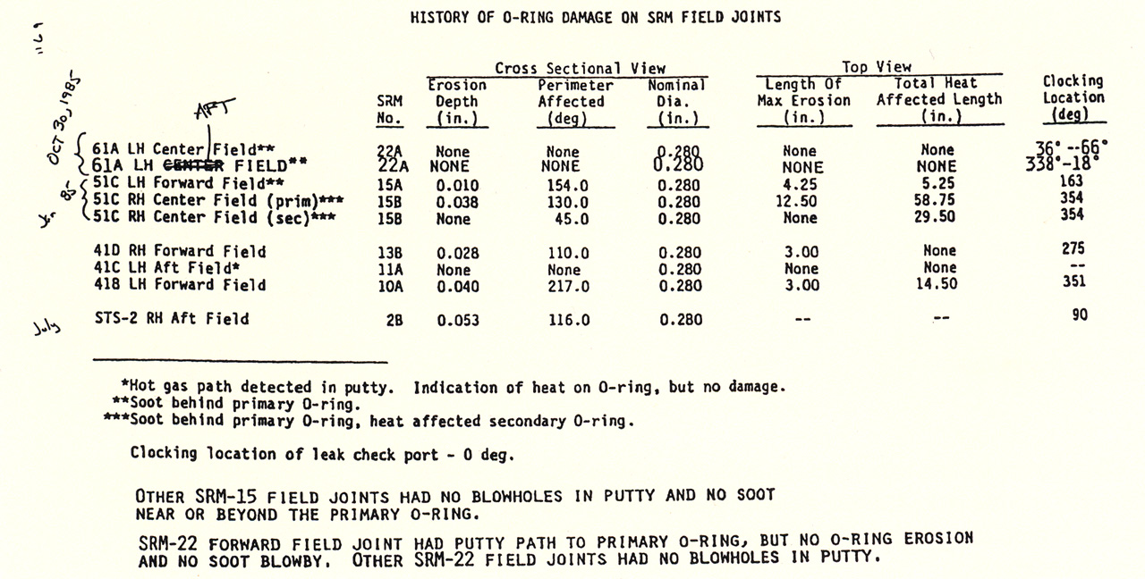
Challenger Disaster
1 of 13 pages of material faxed to NASA by Morton Thiokol
Notes:
Breaks up the damage into many types, doesn’t include temperature.

Slide 22
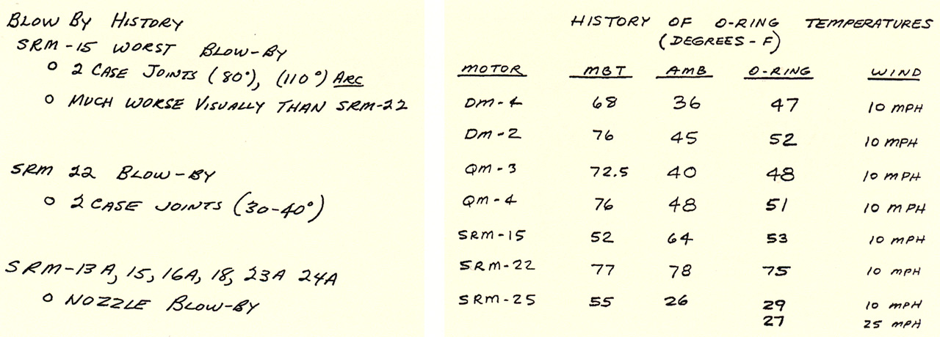
Challenger Disaster
1 of 13 pages of material faxed to NASA by Morton Thiokol
Notes:
Shows only two of the launches (SRM 15 and SRM 22) where there were problems with blow-by..
In both cases there were problems, but the problems were worse in SRM 15
Conclusion – shouldn’t launch at low temps… (faulty – what about the rest of the data? What about things besides blow-by?)
Point – should always be careful to include evidence of failures *and* successes... The differences are the important part!

Slide 23
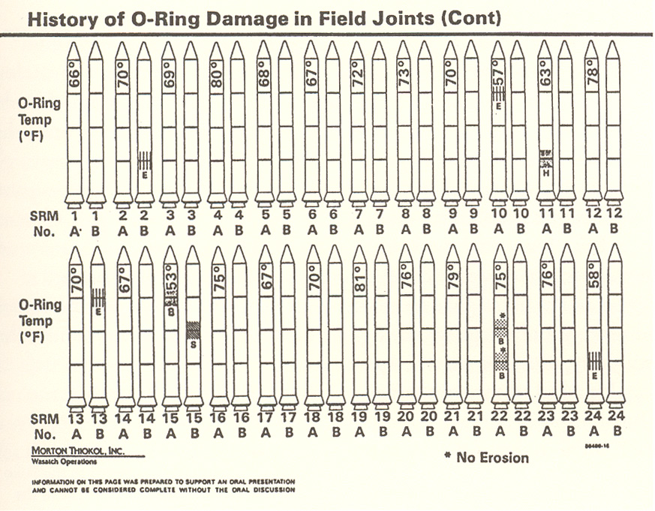
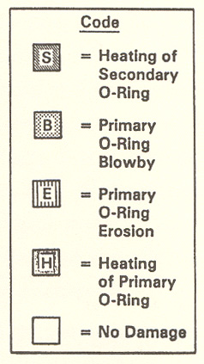
Challenger Disaster
E. Tufte, pp. 46-47 , Visual Explanations
Notes:
Problems:
chartjunk
Order the o-ring problems by temperature
Show both problems and non-problems
Extend the scale to make the point that the launch was much colder than all the previous launches

Slide 24
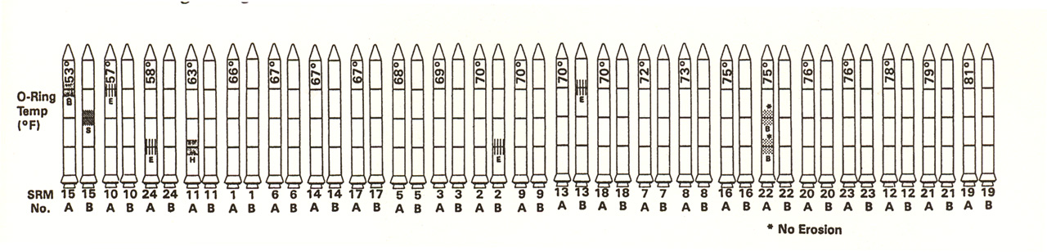
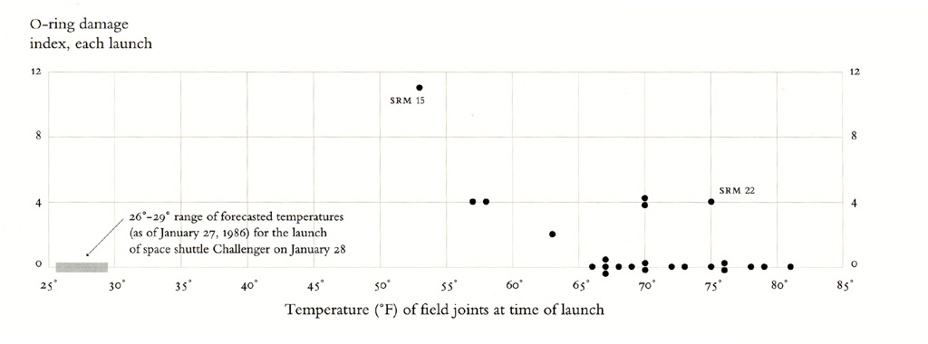
Challenger Disaster
Redrawn by E. Tufte, p. 49 , Visual Explanations

Slide 25
Functions of visualizations
Communicate information to others
Make a point
Tell a story
Make decisions
Support analysis and reasoning
Answer a question
“One image = One diagnosis”
To explore and discover; encourage creativity
Look at things in a new way
“The purpose of computing is insight, not numbers” [R. Hamming]
Inspire
Notes:
John Tukey, EDA, p. vi
“force us to notice what we never expected to see”

Slide 26
The Purpose of Data Visualization is to Help People Think and Communicate

Slide 27
Gulfs of Execution & Evaluation
Gulfs
Evaluation
Conceptual model
(Goals)
Real world (Interactions)
Execution
Norman 1986
Notes:
As simple as moving as pointing your finger to a target.
Example execution:
Manipulating a robot through a textual commands
Manipulating a robot through a telemanipulator
Example of evaluation
a set of data point shown as a table with 2 column?: are they correlated?
a graph showing the same data points are they correlated?
But also can lead to error:
Reading bearing on a non mercator projection,
False alignment,
…

Slide 28
Gulf of Evaluation
Gulf
Real world:
Evaluation
Conceptual
model: x,y correlated?

Slide 29
Gulf of Evaluation
Gulf
Real world:
Evaluation
Conceptual
model: x,y correlated?

Slide 30
Gulf of Evaluation
Gulf
Real world:
Evaluation
ρ = -.29
Conceptual
model: x,y correlated?

Slide 31
Gulf of Execution
Gulf
Conceptual
model:
Draw a rectangle
Real world
Move 90 30
Rotate 35
Pen down
…
Execution

Slide 32
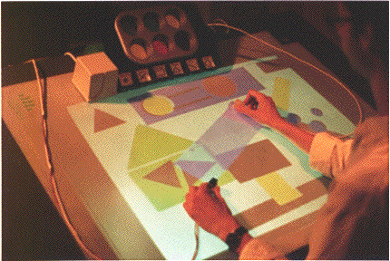
Gulf of Execution
Gulf
Real world
Conceptual
model:
Draw a rectangle
Execution

Slide 33
Visualization: A Double Gulf?
Visualization user
Visualization designer
Evaluation
Representation
Conceptual
model
Visualization
Data
Execution
Manipulation
Notes:
Not in control of the Evaluation and Execution, but the correct pick for the representation and Manipulation can reduce the both gulf of Evaluation and Execution.
Previous lecture on the evaluation
Efficient
Accurate
What about the execution
grasp better understanding
Query the model
Compute
Search answer

Slide 34
Bad visualization?
Visualization user
Visualization designer
Evaluation
Representation
x,y
correlated?
Data

Slide 35
Better Visualization?
Visualization user
Visualization designer
Evaluation
Representation
x,y
correlated?
ρ = -.29
Data

Slide 36
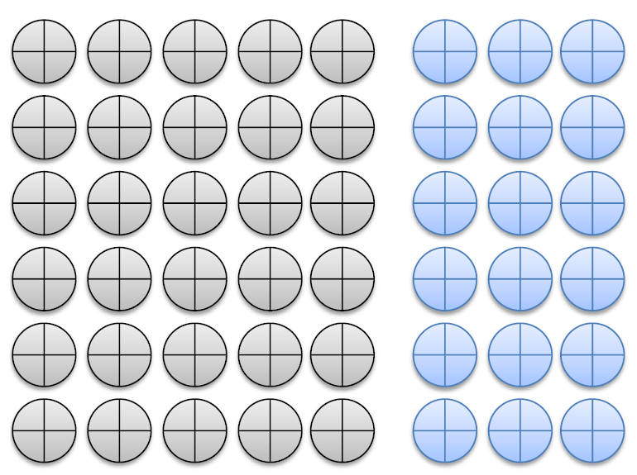
Gestalt Principles
The Gestalt principles are supported by neurophysichologists. The observations
basically address the perception of the whole formed with discrete visual elements and serves as a useful guideline for graphical user interface design.
Proximity
Proximity is the relative distance between objects that affect our perception of whether they form a group. Objects nearer to each other appeared to be a group where the distant ones are not. Based on this principle, buttons for example, can be organized having close functionalities.

Slide 37
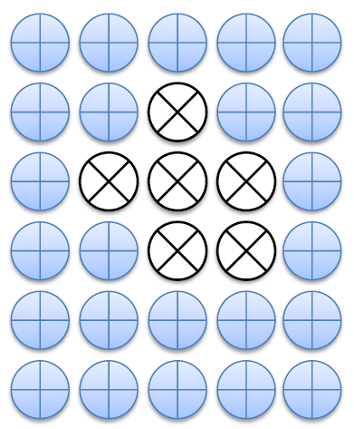
Gestalt Principles
Similarity
Objects looking similar appear to be a group. Shape is predominant in this perception along with size and color. This principle was widely considered during the development of event visualization as well as user interface design.

Slide 38

Gestalt Principles
Continuity
Our visual system has an intrinsic tendency to solve ambiguity or fill missing elements in such that we can perceive a broken chunk of visual information as a whole. However, the principle has not been used intentionally in the design.

Slide 39

Gestalt Principles
Closure
This principle states that our visual system automatically closes open figures to perceive them as a whole. This is somewhat related to similarity principle and we considered the phenomena as an undesired effect that may misrepresent the intended message when a visual scheme yields many elements.

Slide 40
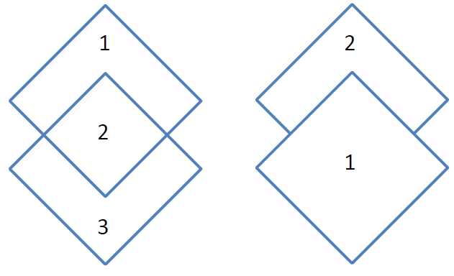
Gestalt Principles
Symmetry
The Gestalt principle of symmetry states our tendency to parse scene in a simpler form. This is our tendency of rejecting cognitive load by forming a simpler pattern in the brain. On the other hand, a visual design supported by this principle improves the visual clarity and reduces visual complexity dramatically.

Slide 41
Gestalt Principles
Figure/Ground
This is a very interesting observation that when a smaller object overlaps a bigger object, the bigger one appears as ground while the smaller one as figure. This principle was a key consideration in nested visual element design and not to be mistakenly used where the similar message was not intended. However, there are situations when it is hard to distinguish between a figure and a ground.

Slide 42
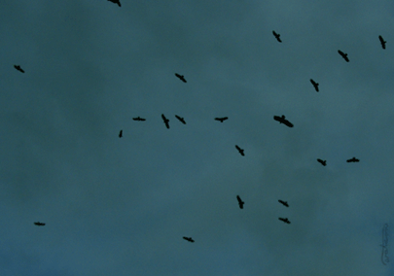
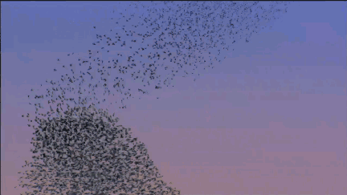
Gestalt Principles
Common fate
Unlike the previously mentioned principles, this principle concerns with the moving objects and is related to proximity and similarity principles. It states that the objects that move together are perceived as a group. Since we haven’t used animation or animated visual effects, this principle was never taken into account.

Slide 43

Gestalt Principles
Combined
In a real-world scenario, Gestalt principles work with combined effect. In a static world, first six principles are in effect, while in a dynamic world, the seventh principle’s participation is almost obvious.

Slide 44
Meaning of Colors
Black: Black is said to be the color of authority and power. It is stylish and timeless and also implies submission.
White: White symbolizes innocence and purity. It is light and neutral and goes with everything.
Red: Red is the most emotionally intense color. It stimulates a faster heart bit and breathing. It is also considered the color of love, probably because heart and red rose symbolizes love or vice versa. The most romantic color pink is close to red. On the other hand, this extreme color is also used for attention.
Blue: The color of ocean and sky. Blue is one of the most popular colors and symbolizes immensity, causing opposite reaction to red. Peaceful, tranquil blue causes calming chemicals production in body. Blue is also the color of coldness and depression.
Green: The symbol of nature and the easiest color on eye that can improve the vision. It is calming and refreshing; hospitals often use green wall color because it relaxes patients. It symbolizes fertility, while dark green is masculine, conservative, and implies wealth.

Slide 45
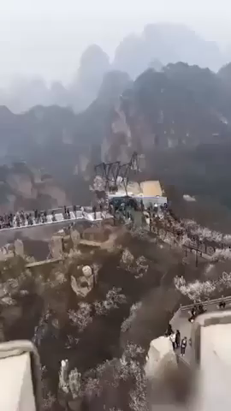
Meaning of Colors
Yellow: Yellow is the symbol of optimism, but it causes people to loose temper on long exposer. It is the most difficult color for the eye to take in, so it can be overpowering if overused.
Purple: Purple is the color of royalty, luxury, wealth, and sophistication. It is also feminine and romantic.
Brown: Solid and reliable brown is the color of earth. Light brown implies genuineness. Brown is also sad and wistful, while men tends to like it.

Slide 46
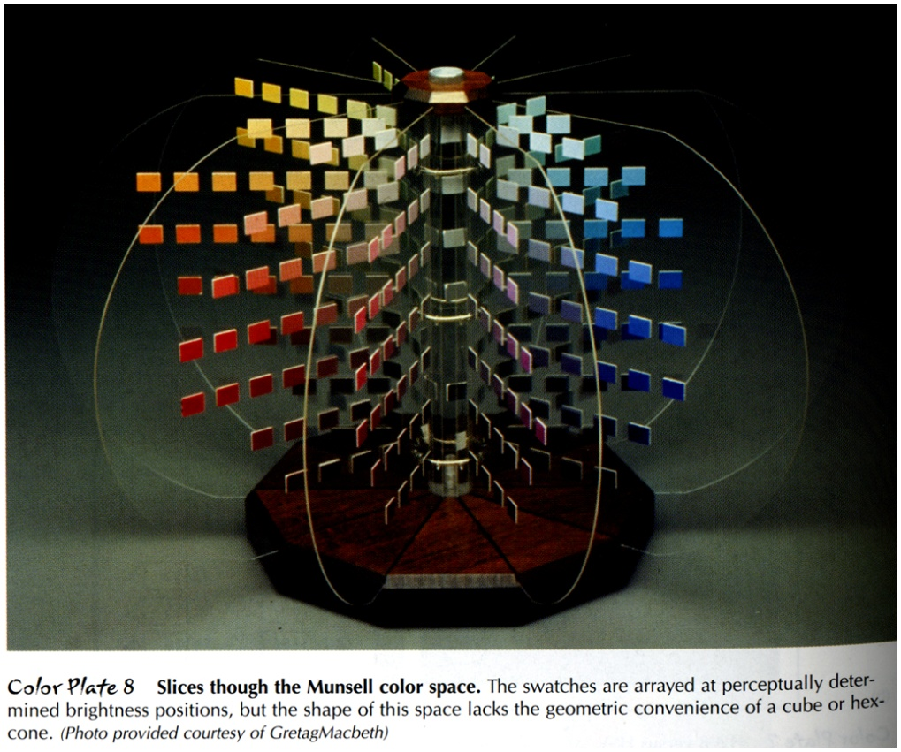
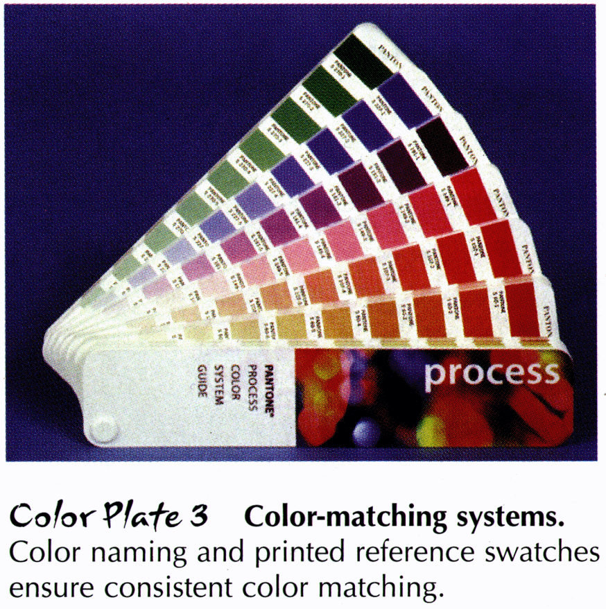
Human-Centered Colors
Munsell (left): Perceptually based
Pantone (right): Functionally based
Anne Spalter, The Computer in the Visual Arts
Notes:
Munsell based on psychology experiments.
Pantone is especially useful for print design. They picked very reasonable colors.

Slide 47
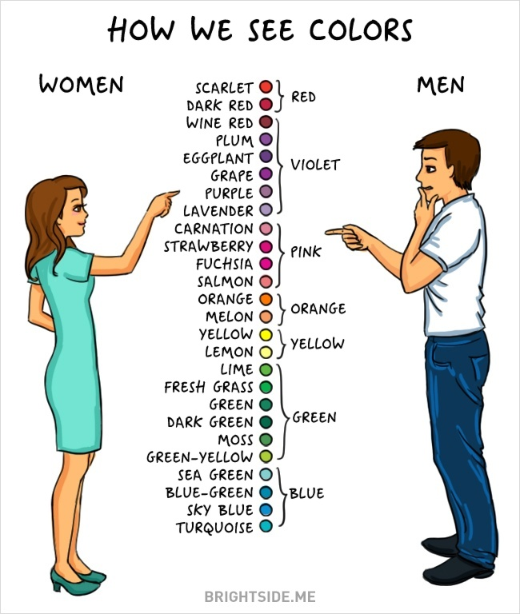
How many colors you see?

Slide 48
How to get color right
Design in grayscale first
Keep luminance values from grayscale when moving to color

Slide 49
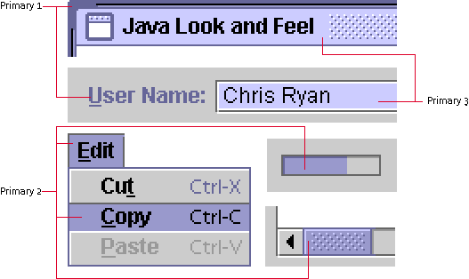
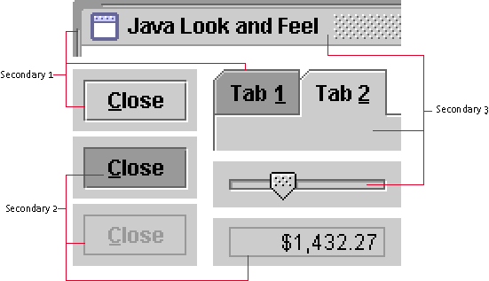
Color (Java L&F)
Six color semantic scheme
Clean, consistent look
Easy on eyes (mostly gray)
Notes:
Same Java look & feel guidelines book
Everything in Java is from 6 colors
Primary colors are all purple and secondary colors are all gray.
When highlighted they have color when not highlighted they have gray.

